Slide 1

Natural Laws
Montana Teen Driver Education and Training
Module 4.1
Notes:
This module presentation has several Powerpoint animations that do not carry forward into the PDF version. It is best presented as a Powerpoint file.

Slide 2
Natural Laws Objectives
Understand the physical laws and concepts that govern driving.
Understand and apply the concepts of Kinetic Energy.
Understand the relationship between friction and traction.
Calculate vehicle momentum and understand the relationship of vehicle mass, vehicle speed and their effects on vehicle crashes.
Use your skills to manage natural laws.

Slide 3
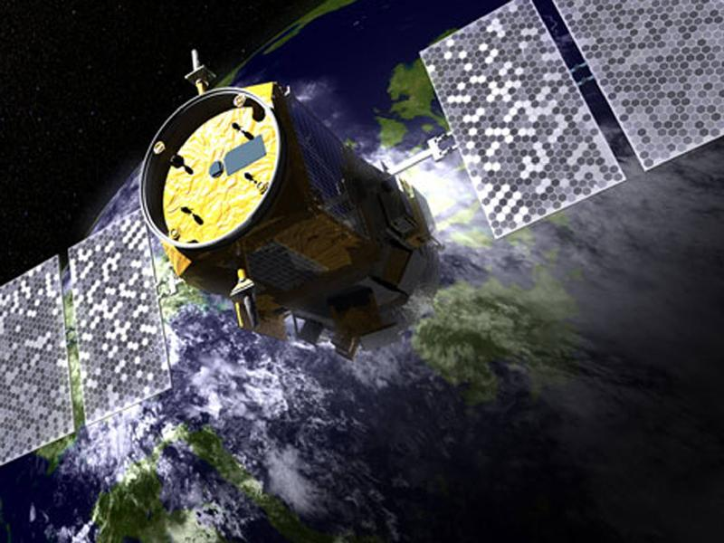
Physics 101
Natural Laws
Notes:
NASA Infrared Pathfinder Satellite Observations
CALIPSO is a mission of the United States and France. Activities such as driving cars and trucks, burning coal and oil, and manufacturing chemicals release gases and small particles known as aerosols into the atmosphere. Forest fires and wind-blown desert dust also produce aerosols. CALIPSO uses Lidar to study the aerosols and thin clouds. LIDAR is a short name for Light Detection and Ranging. It can see things that are invisible to radar. http://www.nasa.gov/mission_pages/calipso/main/index.html
LIDAR is used in Google’s self driving car project with 64 infrared lasers spinning to create a 3-D ongoing 360° model of traffic and the roadway

Slide 4

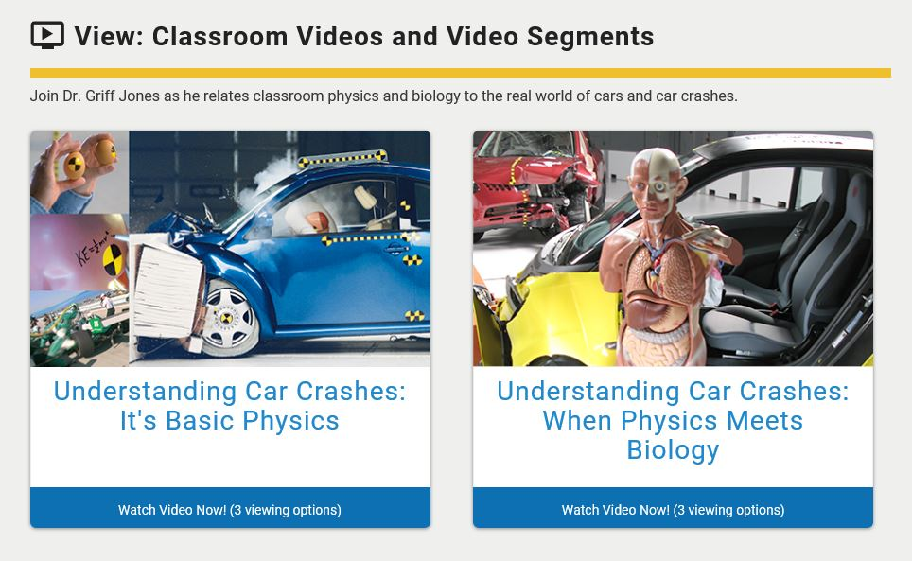
Click on the image below to visit web page with videos. The IIHS in the Classroom link below takes you to all the classroom resources.
IIHS in the Classroom
Notes:
Videos, demonstrations and teacher-developed, classroom-tested activities aligned to the latest science standards bring crash safety STEM applications to grade 5-12 classrooms.
Students and teachers: Explore in class or at home without registration. Explore the videos, demonstrations and activities by yourself, in small groups or as an entire class.
Teachers: Register and sign-in to receive free access to additional teaching resources. Enjoy the additional benefits of downloadable standards-based lesson plans, instructional roadmaps, Teacher Tips videos, answer keys and more.
Launched in 2018, this website aims to reinforce important physics and biology concepts while providing students the knowledge to make safe decisions while riding in or driving a vehicle.

Slide 5
Physics Concepts
Gravity
Kinetic Energy
Momentum
Force
Inertia
Friction
Traction

Slide 6
Gravity
The force that attracts a body toward the center of the earth
  When I jump up I . . . .
  When I throw a ball in the air it . . .
  When I go off a cliff . . .
  Gravity—It’s not just a good idea. . .
    It’s the LAW!
    (The Law of Physics)
Notes:
Ask the questions as they appear and solicit a response from the students. Gravity is one law that can’t be broken. It will always require obedience to the law.

Slide 7
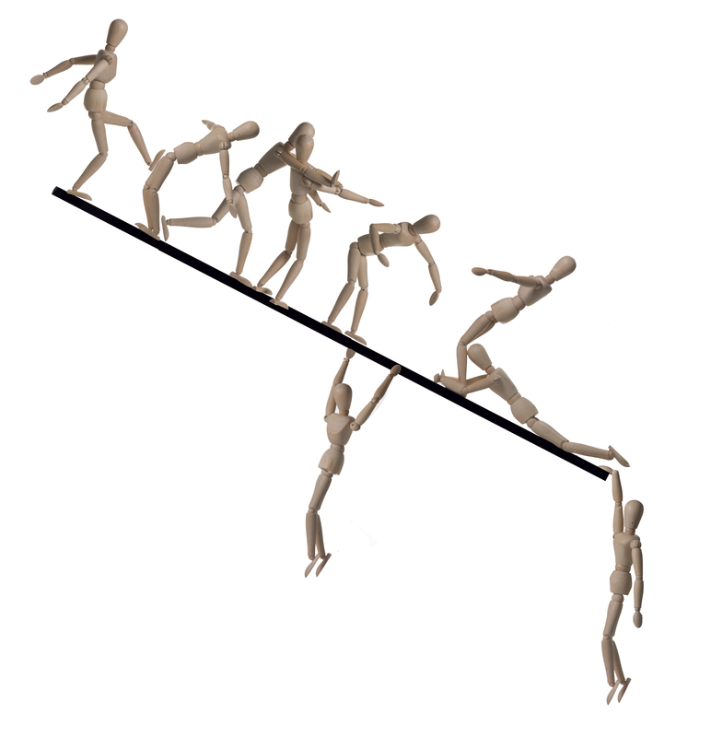
Forces
Each force plays a role in driving.
Notes:
Force of gravity — pulls down on the vehicle helping the car maintain contact with the roadway.
Force of the board pushing upward — keeps the car from falling. This force creates a balance between it and the downward pull of gravity.
Force of Friction keeping them from sliding — the key element of traction. Without friction we would not be able to steer, accelerate or brake.
Force of grasp by others holding them from sliding — this is more symbolic with the way safety belts hold us in place when we are involved in a crash or extremely hard braking.

Slide 8
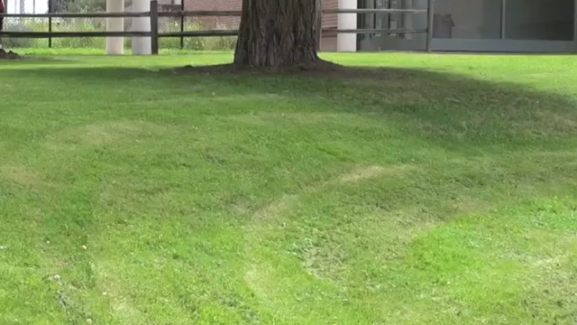
Hills and Gravity
PLAY VIDEO (:51)
Notes:
How would you describe what’s happening with his feet as he runs over the crest of the hill and then at the bottom of the hill?
What do you think will happen if you are driving over a hill? What happens at the bottom of the hill?
The force of gravity is at work the entire time. If you look at the top of the hill the runners actually leave the ground.
At the bottom of the hill the runners feel the ground pushing up and gravity pulling down to the point where one of the runners nearly falls.

Slide 9
Kinetic Energy
Energy of Motion
KE=1/2mv²
KE is for Kinetic Energy
M is for Mass
V is for Velocity
Notes:
Kinetic energy is affected more by the increase or decrease of speed than by the mass of the vehicle.
The equation makes it clear that when I double my speed from 20 to 40 mph I quadruple my KE. Remember that speed is squared so going 20 mph I have 400 units of energy times half the mass of the vehicle. If I go 40 mph I have 1600 units of energy times half the mass of the vehicle effectively quadrupling the KE.
That affects a lot of things:
Energy of the vehicle and occupants in a crash
Energy needed to stop or slow a vehicle
Stopping distance
Cornering

Slide 10
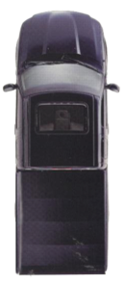
Energy of Motion
20 MPH
40 MPH
Double the speed—quadruple the energy!
Notes:
Remember the Kinetic Energy equation where velocity is squared. Therefore the 6000-pound vehicle has 1.2 million units of energy at 20mph. Doubling the speed of the vehicle gives the truck 8.2 million units of energy.

Slide 11
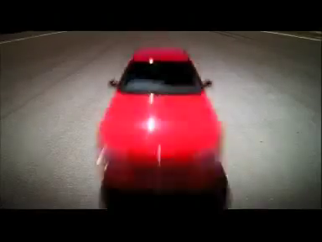
Stopping Distance
PLAY VIDEO (:31)
Notes:
Speed and stopping distance. The faster you go the more distance it takes to stop.
60 kilometers per hour is equal to 36mph.
25 meters is equivalent to 77 feet.
Adding 10 kilometers per hour is adding 6 mph so 70 KPH is equal to 42 miles per hour.
This is a good representation of the dynamics of speed and the effect it has on stopping distance.
This car, traveling at 60 kilometers per
hour, took this long to stop.
“Same car, same driver at 65, this long to stop.
At 70, well … the faster you go the longer it takes to stop.
Slow down, stick to the limit, because enough is enough.”

Slide 12
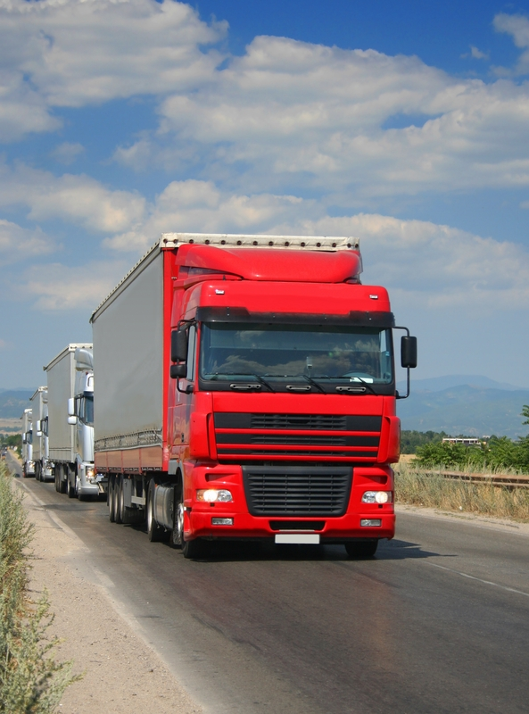
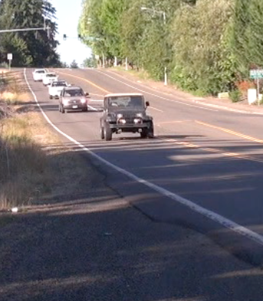
Stopping Distance
Notes:
Using what we know from the Kinetic Energy equation, which of these two vehicles traveling at the same speed will take longer to stop?
Which one has the most kinetic energy if they were going the same speed? The 80,000-pound truck or the 4000-pound SUV?
Put the answer in terms of the Kinetic Energy equation.

Slide 13
Momentum
Mass in Motion
  How much stuff and how fast the stuff is moving in one direction
  Momentum = mass x velocity
Notes:
Momentum adds the directional component. It is the mathematical description of how much mass is moving at what speed and includes the component of direction.

Slide 14
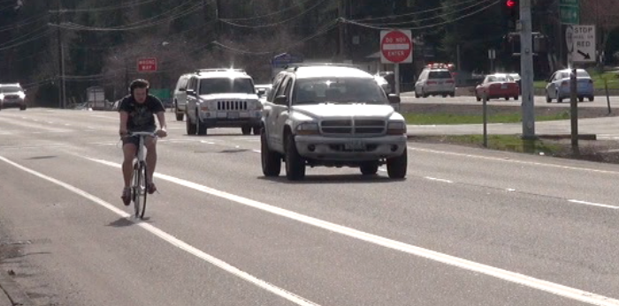
Momentum
Both the cyclist and SUV are traveling at the same speed—20 mph.
Which has the greater momentum?
Notes:
Doing the math the 5000-pound SUV has the most momentum. The formula of p=mv translates into 5000 x 20mph equals 100.000 units of momentum. The 200 pound cyclist at the same speed has 4000 units of momentum. Put simply, the SUV has 25 times the momentum of the cyclist and that helps explain why car/cyclist crashes are so devastating to cyclists. That all translates into the energy in a crash.

Slide 15
Energy in a Crash
Student Activity 1: Force of Impact
Stand 1-2 inches from a wall with hands up facing wall and go as fast as possible into the wall protecting yourself with your hands. (Similar to sport coaches saying to run through the finish line.) Ask if there were any injuries.
Step back one step and do the same, protecting self with the hands to prevent injury. Discuss whether or not injury could occur from this distance and why.
Now step back five steps and ask what the results would be if you were to go through the finish line or wall from this distance. DO NOT actually run into the wall from this distance nor have a student attempt this.
Notes:
Speed and impact student activity:
This is a great way to spark a discussion about vehicle crashes involving speed and injuries with impact distance. It is also a great way to reinforce the riding down effects of seat belts when involved in a crash.

Slide 16
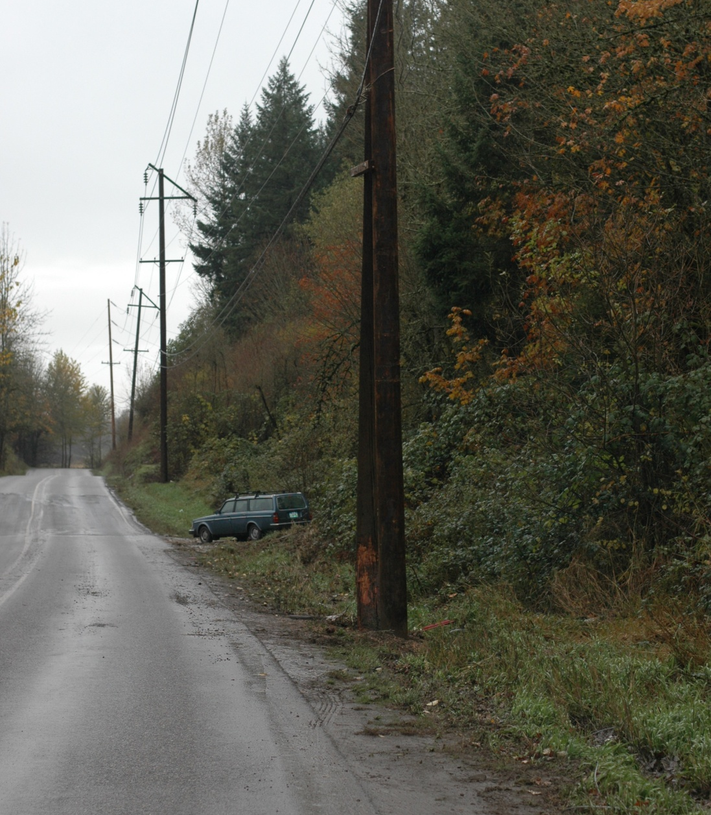
Check out this road …
Describe what you see:
Roadway design
Road surface conditions
Space for error
As the driver, what decisions should you make?
Notes:
Review the slide, lead the students in a discussion about how road design and surface can contribute to a crash.

Slide 17
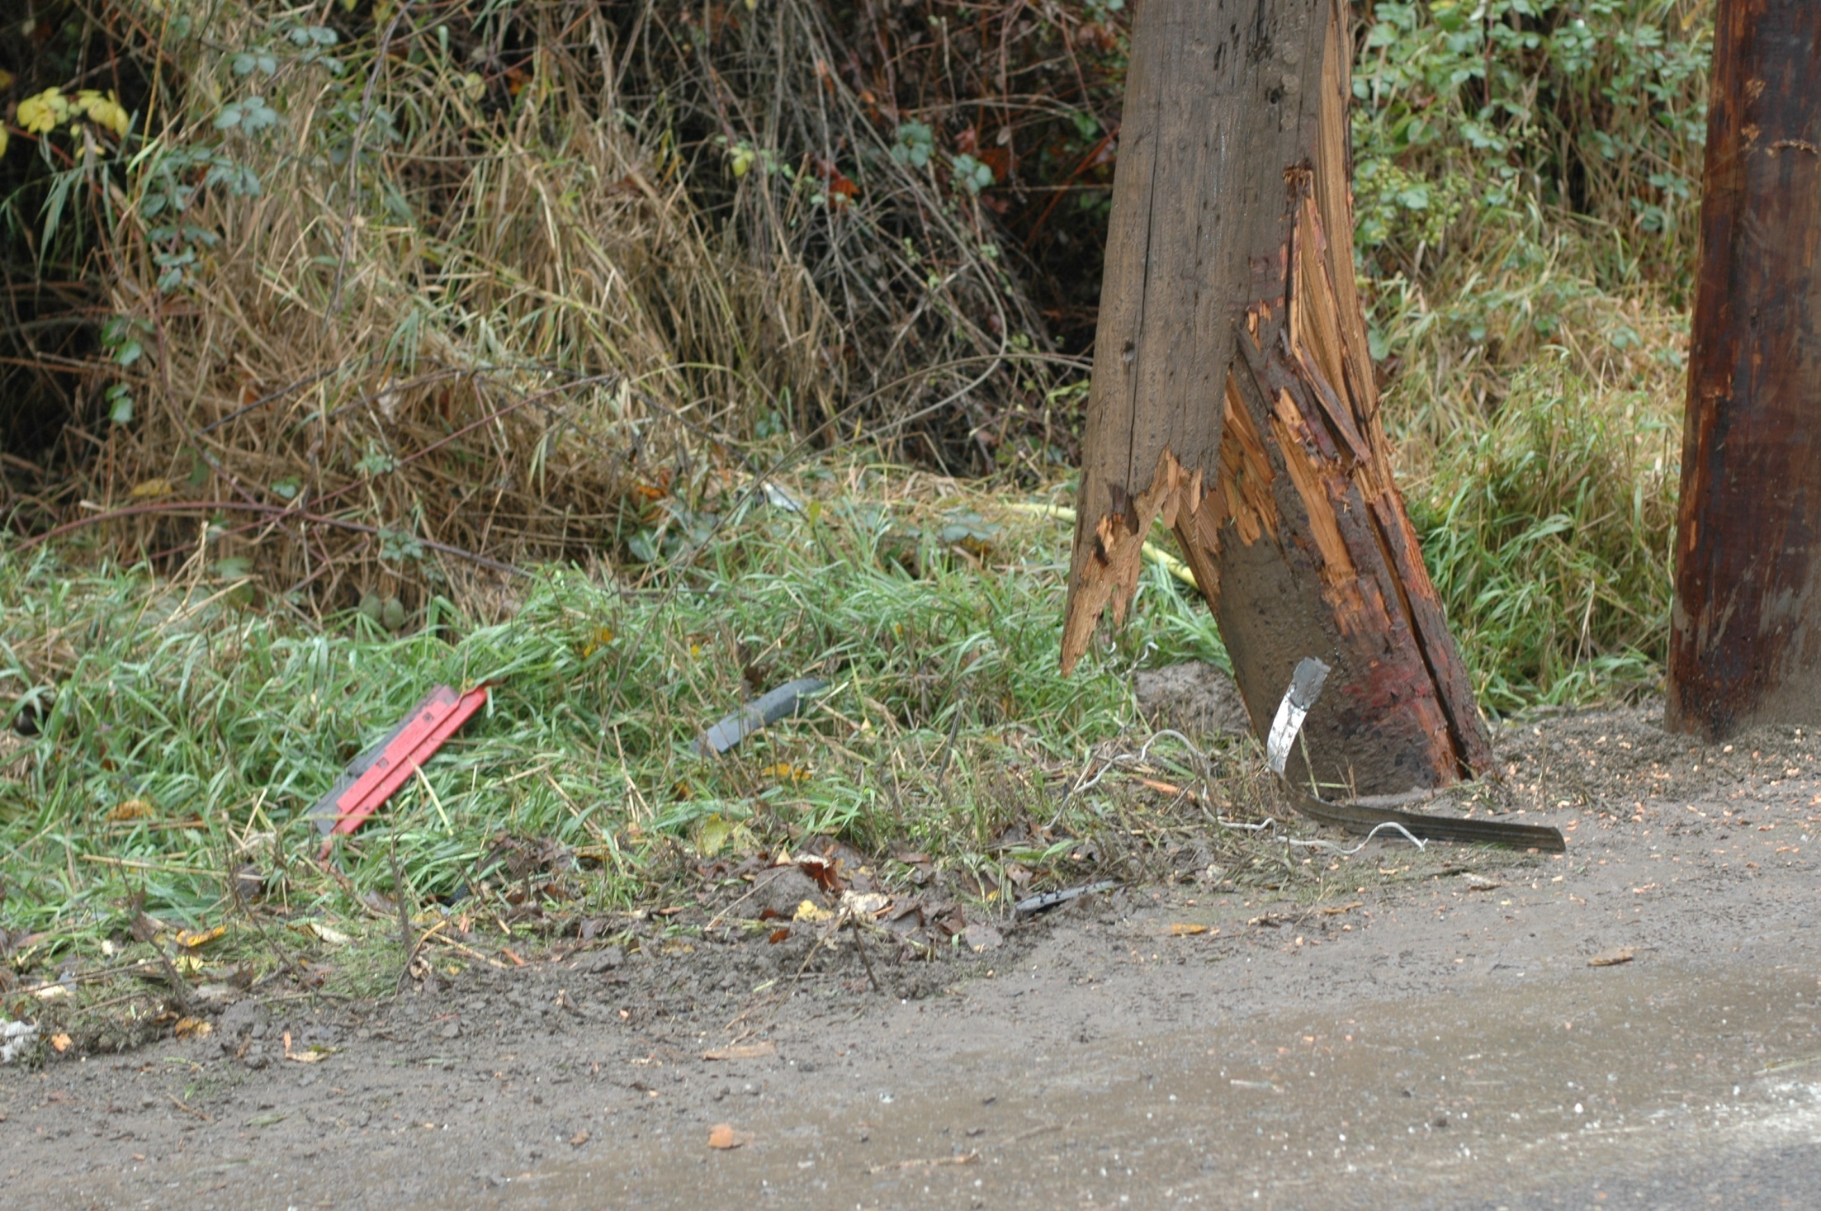
QUESTION:
What would cause this 25-inch diameter high voltage power pole to break like this?
Notes:
This is a great time to talk about forces and energy in a crash. It took a lot of energy to break this pole. It is a 25 in diameter high voltage power pole that is buried 8 feet in the ground. The pole next to it was installed after the crash to support the electrical wires. The next slide has a picture of the vehicle that hit the pole.
Questions you might want to ask:
What kind of car caused this break?
How fast do you think it was going?
Is it possible that someone could have been killed or injured in this crash?
Could you survive a crash where your car caused the pole to break like this?

Slide 18
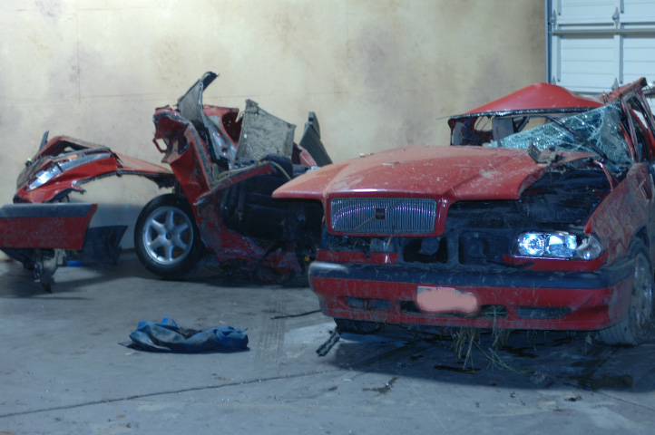
ANSWER:
This Volvo traveling at 100mph when it lost control and struck the power pole!
Notes:
This is a picture of a car involved in a crash in Oregon. The driver was a 17 year old high school student who was joy riding in his parents car by himself. He was driving 100 mph on a rain slicked hilly road when he lost control and slid passenger side into the pole. Fortunately for him, he was wearing his safety belt and the airbags did deploy. He doesn’t remember getting out of the car after the crash but remembers standing by the side of the car trying to figure out what happened.
Several things are certain. Speed and rain were a factor in the crash and inexperience contributed as well. Three fortunate things happened with this crash. The quality of the vehicle and its safety features, no one else was in the car, and he struck the pole on the opposite side of the driver’s side.
The car literally broke in two at impact with the pole. The pole cost $25,000 to replace—let alone the cost of the car and the possible loss of life.

Slide 19
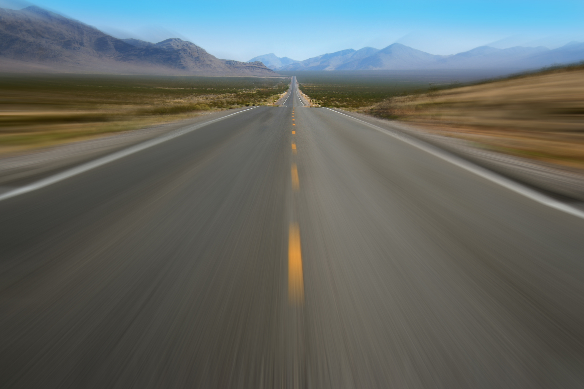
That’s why speed kills!
Notes:
This is a good time to lead a discussion on how speed affects the following:
Traction
Vehicle dynamics
Cornering
Cresting hills
Bottom of hills
The increased energy changes the way the car handles and therefore makes it more difficult to control for the novice driver.

Slide 20
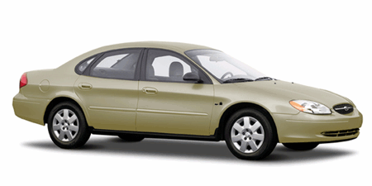
Remember Vehicle Balance
PITCH, ROLL, YAW?
Yaw
Pitch
Roll
Notes:
This is a quick review of what the students have already learned so you don’t have to spend a lot of time on this, but it is important to remind them how a car behaves on the 3 axis.
Working outside the natural laws will cause the car to rotate around the three different axis. This can be gentle or it can be quite out of control. Consider the following diagrams and do the student activities to recall how the car will move around these axis.

Slide 21
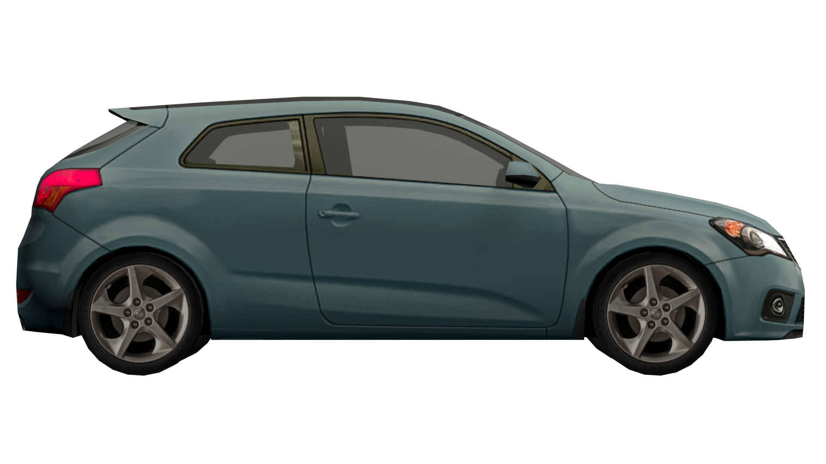
Pitch
Notes:
Pitch is caused by braking too hard or accelerating too rapidly.

Slide 22
Student Activity 2: Pitch
Stand up.
Pretend that you are in a car moving at 35mph.
The driver slams on the brakes.
Demonstrate what your body does when the car suddenly stops.
Notes:
Instructions for this activity are on the slide.

Slide 23
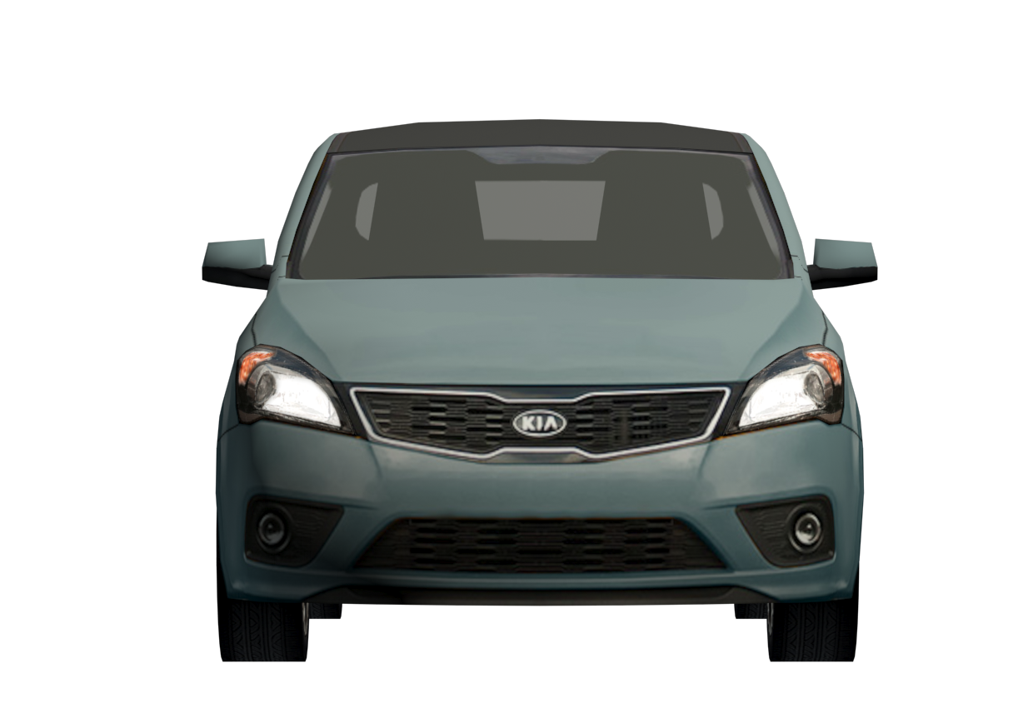
Roll
Notes:
Roll is the movement of the car around an axis that runs from the front grill, through the car, to the trunk.
It is caused by turning too quickly at speed. The weight is transferred to the tires on the outside of the turn.
If the speed is increased and the force is sufficient the vehicle can roll completely over.

Slide 24
Student Activity 3: Roll
Stand up.
Pretend you are traveling in a car moving at 35mph.
The driver turns sharply to the left.
Demonstrate what your body does when the driver turns.
Notes:
Instructions for this activity are on the slide.
Remember to have them lean in the opposite direction.

Slide 25
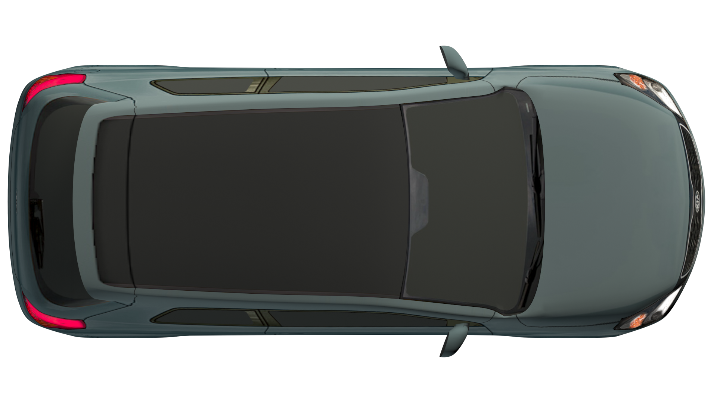
Yaw
Notes:
Yaw is the movement around the axis that runs through the center of the car from the floor to the roof.
Movement can be as subtle as a slight side-to-side movement around the axis to a 180 or 360 degree spin.

Slide 26
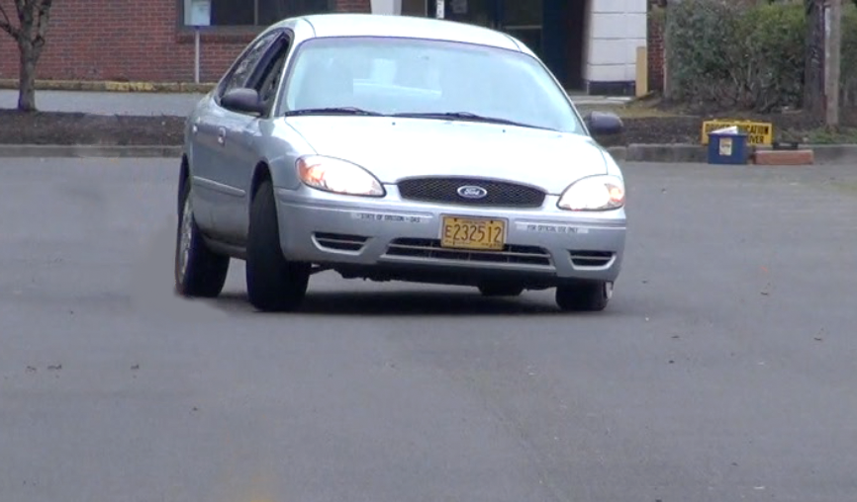
Describe what is happening to this vehicle in balance terms.
Roll
Yaw
Pitch
Notes:
Have the students describe what they see in terms of Pitch, Yaw, and Roll.

Slide 27
FRICTION

Slide 28
Friction
The force when two surfaces move against each other and one surface resists the other.
Described in terms of a coefficient of friction.
Different surfaces have different coefficients of friction.

Slide 29
Student Activity 4: Friction
Put your palms together and press them together firmly
Rub them back and forth quickly for 30 seconds
What happened as you rubbed your hands together?
Notes:
The purpose of this activity is to let the students discover friction. The heat is an indication that there is friction between the two surfaces. This translates into the concept of traction. Traction is the four tires making contact with the road and providing “grip” to hold the car on the road as we accelerate, stop, or turn.
If they press hard enough they will notice that their hands won’t move. They will learn that when the force of friction is greater than the force to move their hands, nothing moves.

Slide 30
Static Friction
Force of Friction
Gravity
Force of friction is equal to or greater than the force of gravity
Object doesn’t move or remains static
Notes:
Static friction is the friction that keeps the block from moving. Equal force is exerted on the box and slope, and is sufficient to overcome the downward force of gravity which would cause it to slide.

Slide 31
Sliding Friction
Force of Friction
Gravity
Friction
When the force of friction is less than the force of gravity
Object slides down the slope
Notes:
When the force of friction is less than the force of gravity, the object will slide down the slope. The same is true on a flat, icy or snowy surface. It overcomes the force of friction and slides down the slope.

Slide 32
Sliding Friction and Mass
Notes:
Mass also plays a role in friction. The lighter the object, the more likely it will slide. Consider what happens to a pickup truck on a snowy day. The back end is very light and slips easily on the roadway. One thing to do is to add weight to the back end with sand bags, which increases the friction or traction with the road.
Going over the crest of a hill, like you saw in an earlier slide, creates the same effect. As you crest the hill the car loses some of the contact with the roadway and friction is reduced. If the driver crests a hill and also turns the wheel to steer through a curve, the friction of the tires and roadway is reduced.

Slide 33
Rolling Friction
Friction between the ground and the tire
Notes:
We rely on rolling friction to keep us on the road. However, the road opposes the motion of the tire when it rolls along the surface. Rolling friction occurs because tires flatten slightly during contact. The amount of friction increases the more the tire flattens or deforms. If the friction increases, the tire will heat up just like your hands did when you were rubbing them together.
Proper air pressure will help manage heat buildup. Too high air pressure will reduce the ability of the tire to deform and reduce the friction and traction.

Slide 34
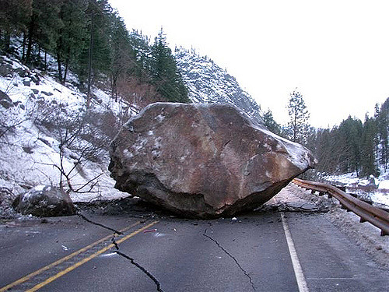
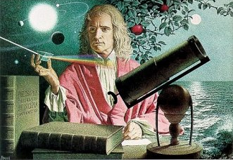
Inertia
An object at rest. . . . .
An object in motion. . . .
First published in 1666 by Sir Isaac Newton in
Principia Mathematica Philosophiae Naturalis.
Notes:
Inertia is a property of matter that causes it to resist changes in velocity (speed and/or direction). According to Newton's first law of motion, an object with a given velocity maintains that velocity unless acted on by an external force. That external force could be wind, road friction, gravity or any combination of things. Inertia is the property of matter that makes this law hold true.
The amount of inertia that an object possesses is proportional to its mass. However inertia is not the same thing as momentum (the product of velocity and mass). The mass of an object can be measured by observing the extent of its inertia. This is done by measuring the amount of force required to produce certain acceleration such as getting an object moving, redirecting its path or stopping the object.
Inertia is a physics term. Sir Isaac Newton discovered that a body at rest would stay at rest and a body moving through space would continue moving through space unless an external force (like friction or gravity) caused it to slow down, stop, or change directions.

Slide 35
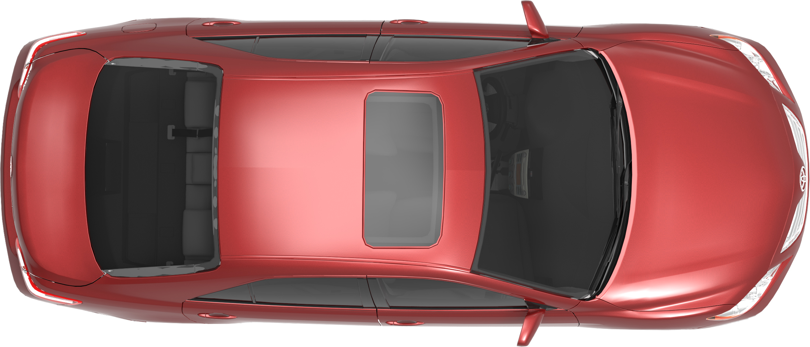

Normal conditions with good traction.
Traveling posted speed in curve.
Proper steering, braking and acceleration at the transition peg.
The car will follow the intended path.
Intended Path
Notes:
Questions you may want to ask:
What are the forces that are holding the car on the road?
Answer—Friction of the road and the tires
Answer—Low enough speed that the tires will not exceed the “coefficient of friction.” If the speed is too fast the car will lose its ability to stay on the roadway as seen in the next slide.
What happens to your body as the car goes around this corner? Why do you think that is?
Answer—The body will continue ahead but the seat or door changes the direction you are going. It provides the force to redirect your energy.
Knowing what you do about vehicle dynamics, what do you predict the car is doing at this time in terms of Yaw, Pitch, or Roll? What causes the car to respond that way?
Answer—The property of inertia will cause the car to continue straight ahead. The tires redirect the energy of the car to the new direction. Because the car is on a suspension and flexible tires, the car will roll to the right as it makes a left turn. If braking occurs the car will also pitch forward onto the front right tire.

Slide 36
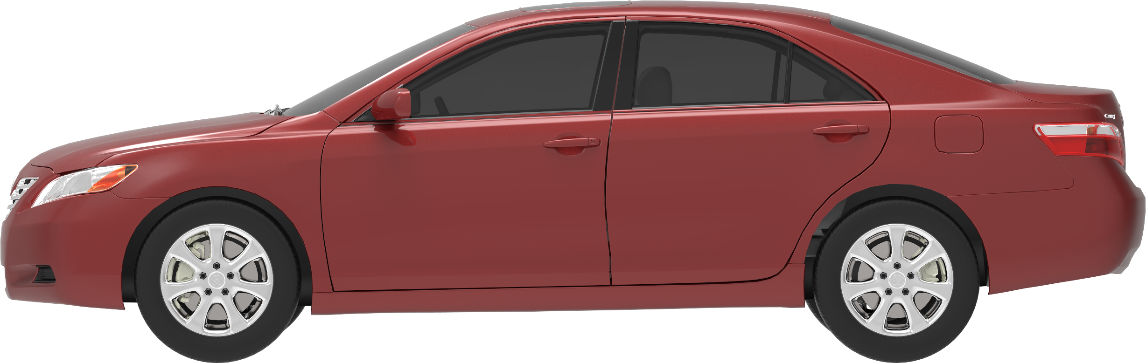

Normal conditions with good traction.
Traveling at higher speeds.
Improper steering, braking or acceleration at the transition peg.
The car will proceed off the roadway and into a crash.
Intended Path
Actual Path
Notes:
Mismanaged forces will cause the vehicle to take an unintended path and possibly roll over.

Slide 37
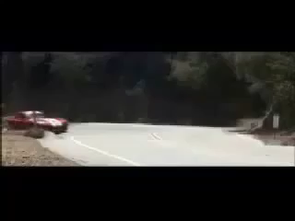
Gravity demands obedience.
PLAY VIDEO (:09)
Notes:
Consequences of speed, loss of traction and a cliff. Gravity demands obedience. This car is designed for high speed maneuvering, but even it has its limits.

Slide 38
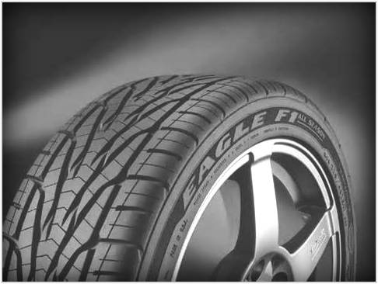
What is traction?
The ability of the tires to
grip the surface of the road.
What limits the amount of
traction?
  Conditions of tires
  Conditions of the roadway
  Vehicle speed, pitch, and roll forces

Slide 39
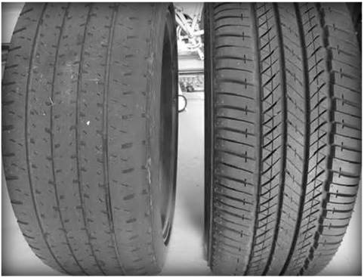
Which tire has better tread?
How can you tell?
Notes:
The tire on the right provides better traction especially in wet and snowy conditions. The deeper tread allows water to channel away from the road and the tire remains in contact with the roadway.

Slide 40
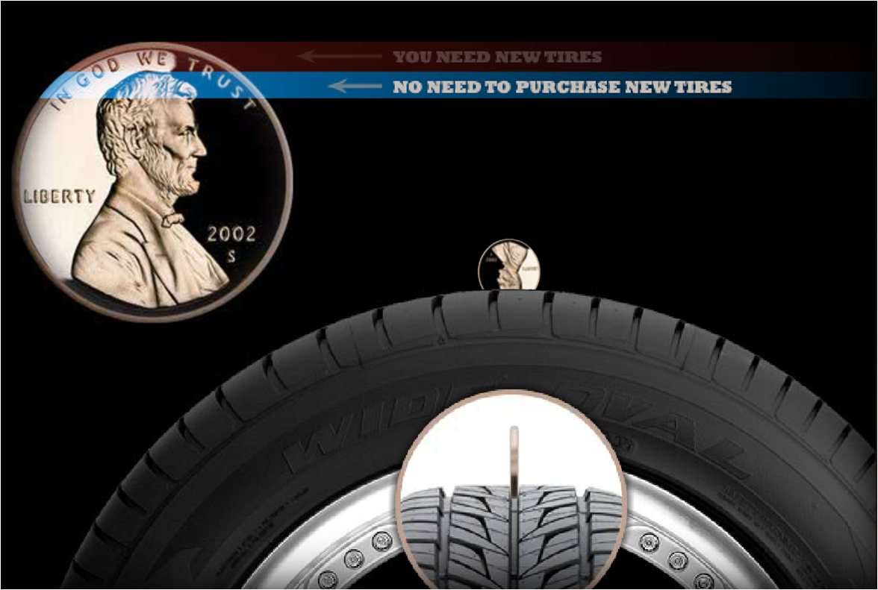
Notes:
How do I know when I need to replace my tires? When you put a penny in the tire tread, President Lincoln’s head is completely exposed.

Slide 41
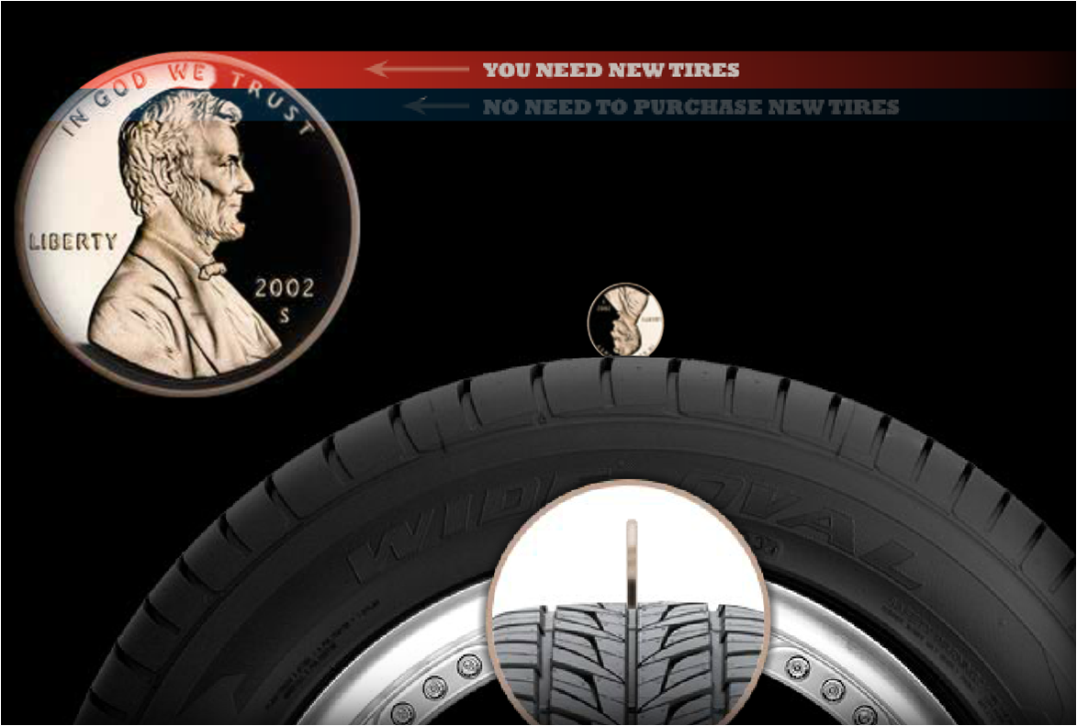
Notes:
Time to replace this tire!

Slide 42
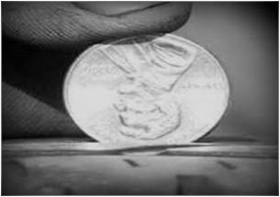
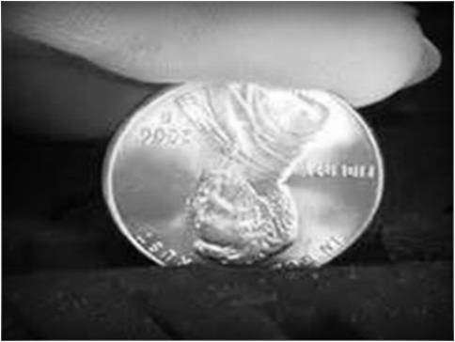
Which tire needs to be replaced? Can you tell?
A
B
Both tires need to be replaced.
Notes:
Both tires need to be replaced because Lincoln’s head is completely exposed.

Slide 43
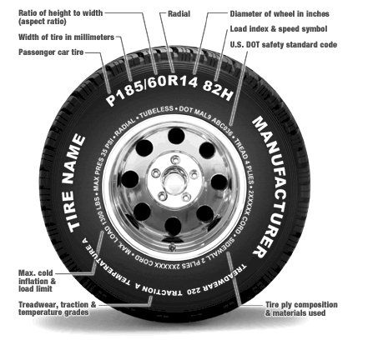
Tire
Markings and
Information
Routinely check your tire pressure!
Notes:
Where do you find maximum tire pressure?
Where do you find recommended tire pressure?
What is the difference?
Where you find maximum load information?
How do you check the tire pressure?

Slide 44

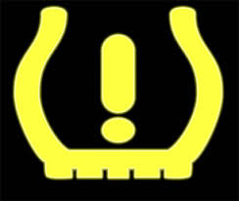
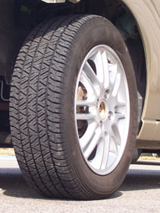
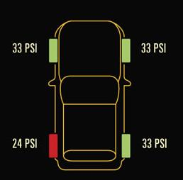
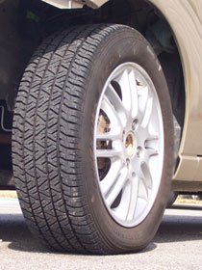
Tire at 32 psi
100% recommended pressure
Tire at 16 psi
50% recommended pressure
Notes:
http://www.safercar.gov/ Promoting+Tire+Safety
Tire pressure monitoring systems (TPMS) measure pounds per square inch (PSI).
TPMS will light up on dashboard when any tire is 25% under-inflated.
Which would have higher recommended tire pressure?
Racing Bicycle tires 65 – 110 PSI
Mountain Bike tires 36- 44 PSI
Tractor tires 14 – 22 PSI
Car tires 33 - 35 PSI
Criteria to calculate the right pressure:
Size of tires
Maximum speed
Total weight supported by tires: machine weight +weight of tools + load transfer

Slide 45
Student Activity 5a: Traction
Partners face each other, place your palms together and push against each other. One partner is the tire patch, the other is the roadway.
The one being the tire will move their hands about and the roadway follows. Have them move their hands slowly at first and see how the roadway responds. Then move their hands around quickly. What happens to the tire’s ability to “hold the road”?
This demonstrates that traction is a function of friction and pressure.
Notes:
Partners face each other, place your palms together and push against each other
One partner is the tire patch, the other is the road.
The one being the tire will move their hands about and the roadway follows.
Have them move their hands slowly at first and see how the road way responds.
Then move their hands around quickly. What happens to the tire’s ability to “hold the road”?
This demonstrates that traction is a function of friction and pressure.
An addition to this activity: you may want them to change the pressure on their hands together simulating what happens to traction when the vehicle goes over the crest of a hill and the car lifts a little.
Refer to the friction activity where a foreign substance was added to the road such as oil or water. What do you predict will happen with the tires ability to “hold the road”?
Lighten the pressure and have them move their hands around. Explain what happens.

Slide 46
Student Activity 5b: Loss of Traction
Put your palms together and hold them together firmly.
This time add hand lotion or baby oil or water.
Rub them back and forth quickly for 30 seconds.
What happened this time as you rubbed your hands together?
Notes:
Now we add the oil or lotion which simulates the presence of rain, snow or ice. They will notice how easy it is to move their hands and feel the loss of traction.

Slide 47
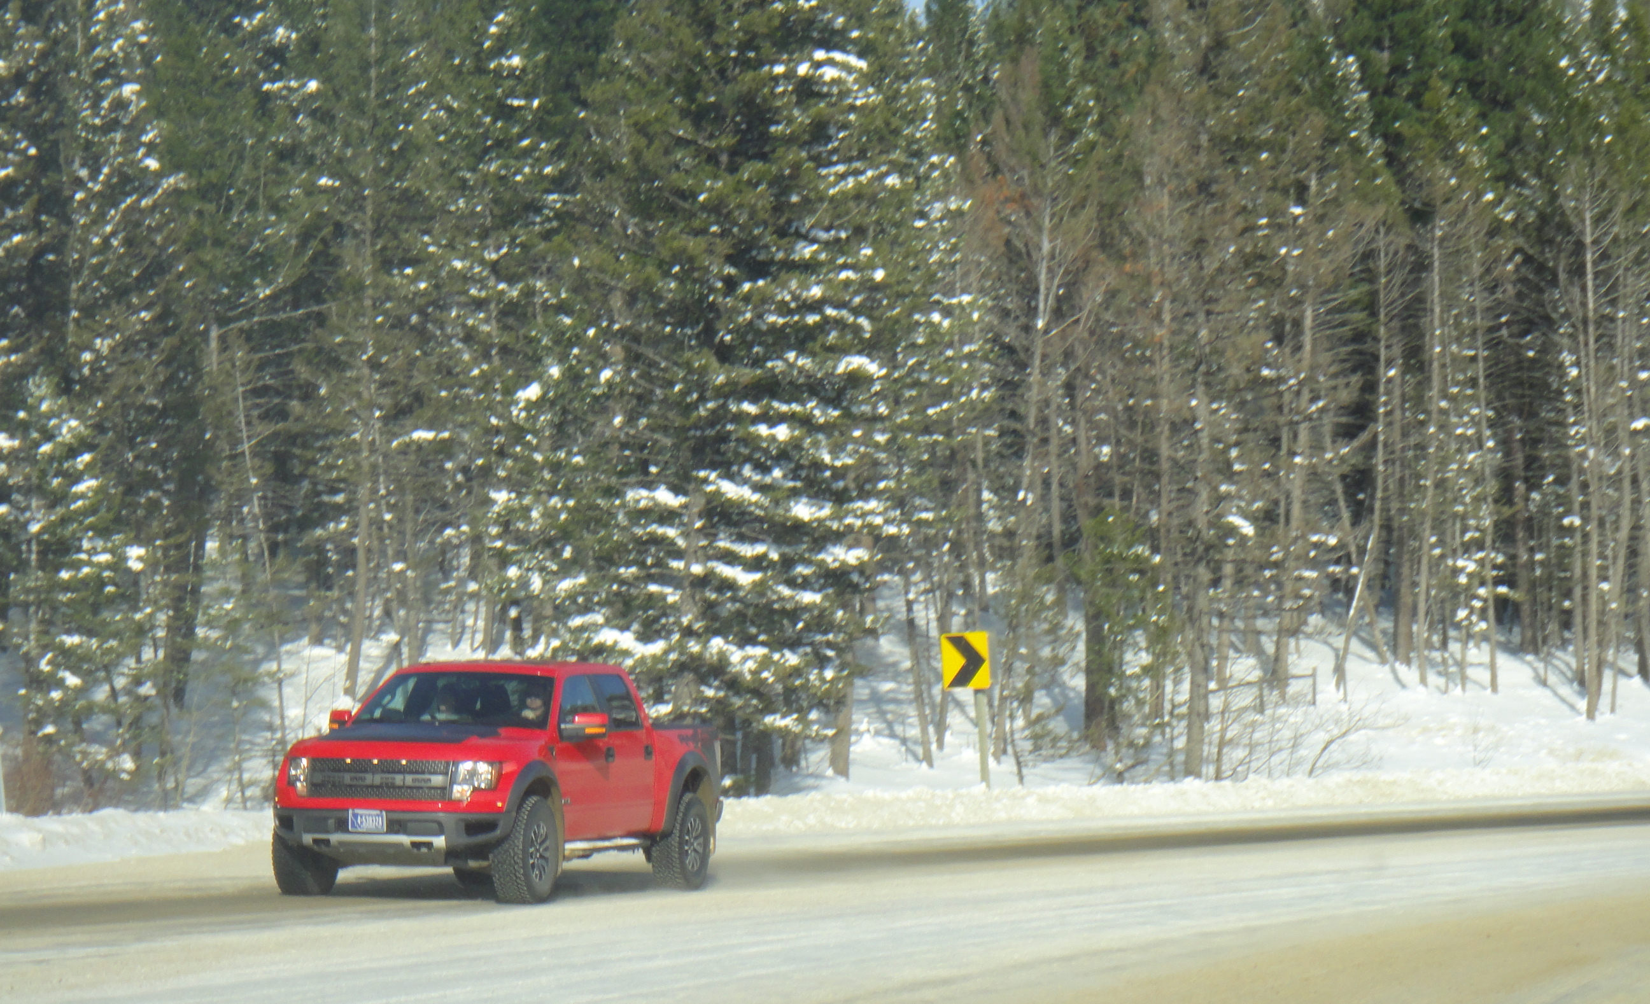
Momentum in Winter
Notes:
What happens to momentum in the winter? It stays the same.
What happens to traction on a snowy road? It becomes less.
In order to manage the momentum in situations when the traction is less. the only way to do that is to SLOW DOWN!!!
However, sometimes when you are going up a hill it is important to use your momentum to keep you moving so you can crest the hill before you lose traction.

Slide 48
MAXIMUM VEHICLE LOAD

Slide 49
Vehicle Load Considerations
Vehicle type and design
Tires
Suspension
Height
Width
Number of passengers
Amount of gear
Notes:
Vehicle type: Is it a truck, a passenger car, a Smart car? What kind of car is it and what is it designed to haul?
Tires: Are they passenger tires, truck tires, and are they rated to carry certain types of loads?
Suspension: Is it a truck or passenger suspension? Has the suspension been altered to “lift” the truck or lower it closer to the ground?
Height: Is it a tall vehicle with an even taller load or a short vehicle such as a sports car and how many seats does it have.
Width: Does it have a narrow or wide wheel base and how does that affect its handling?

Slide 50
EXCEEDING MAXIMUM LOAD
Notes:
Every vehicle is designed to carry a maximum load. It is important to make sure you don’t exceed the vehicle load because it drastically changes the handling characteristics of the vehicle. Why does that happen?

Slide 51
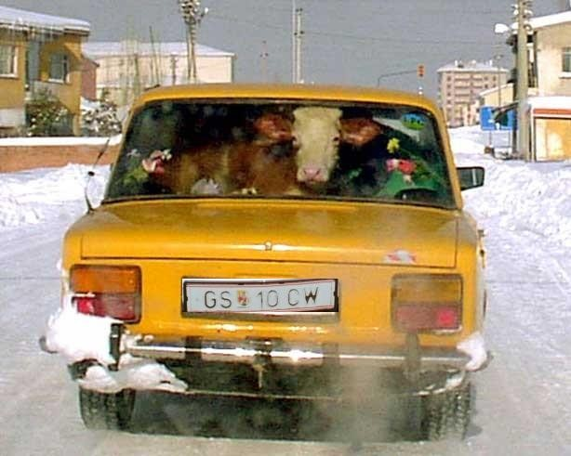
Notes:
The next three slides are examples of loads that probably exceed the maximum.

Slide 52
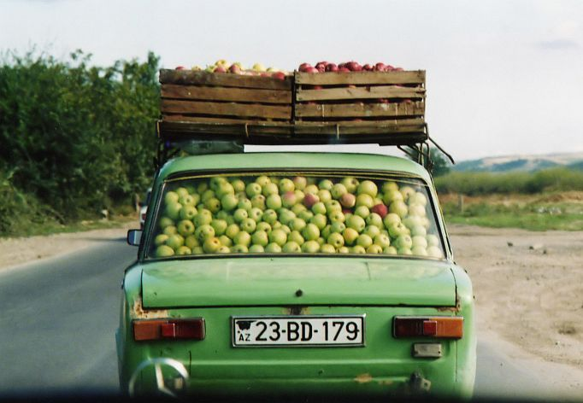

Slide 53
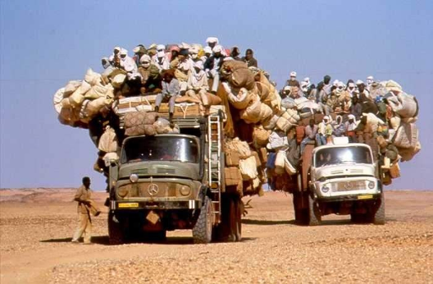

Slide 54
LOAD AND BALANCE
“Center of Gravity”
Notes:
Center of gravity and vehicle load affects the driver’s ability to manage vehicle balance, because as we increase vehicle load we also change the center of gravity.

Slide 55
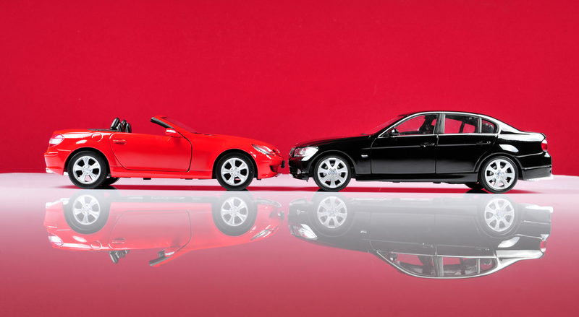
Height of the Vehicle
Center of Gravity
Notes:
Which vehicle has the highest center of gravity?
How will that affect the vehicle balance when the vehicle goes around a corner? Describe it in terms of Yaw, Pitch, and Roll.

Slide 56
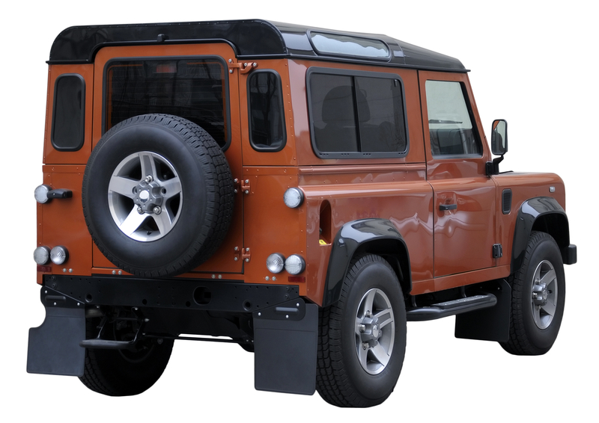
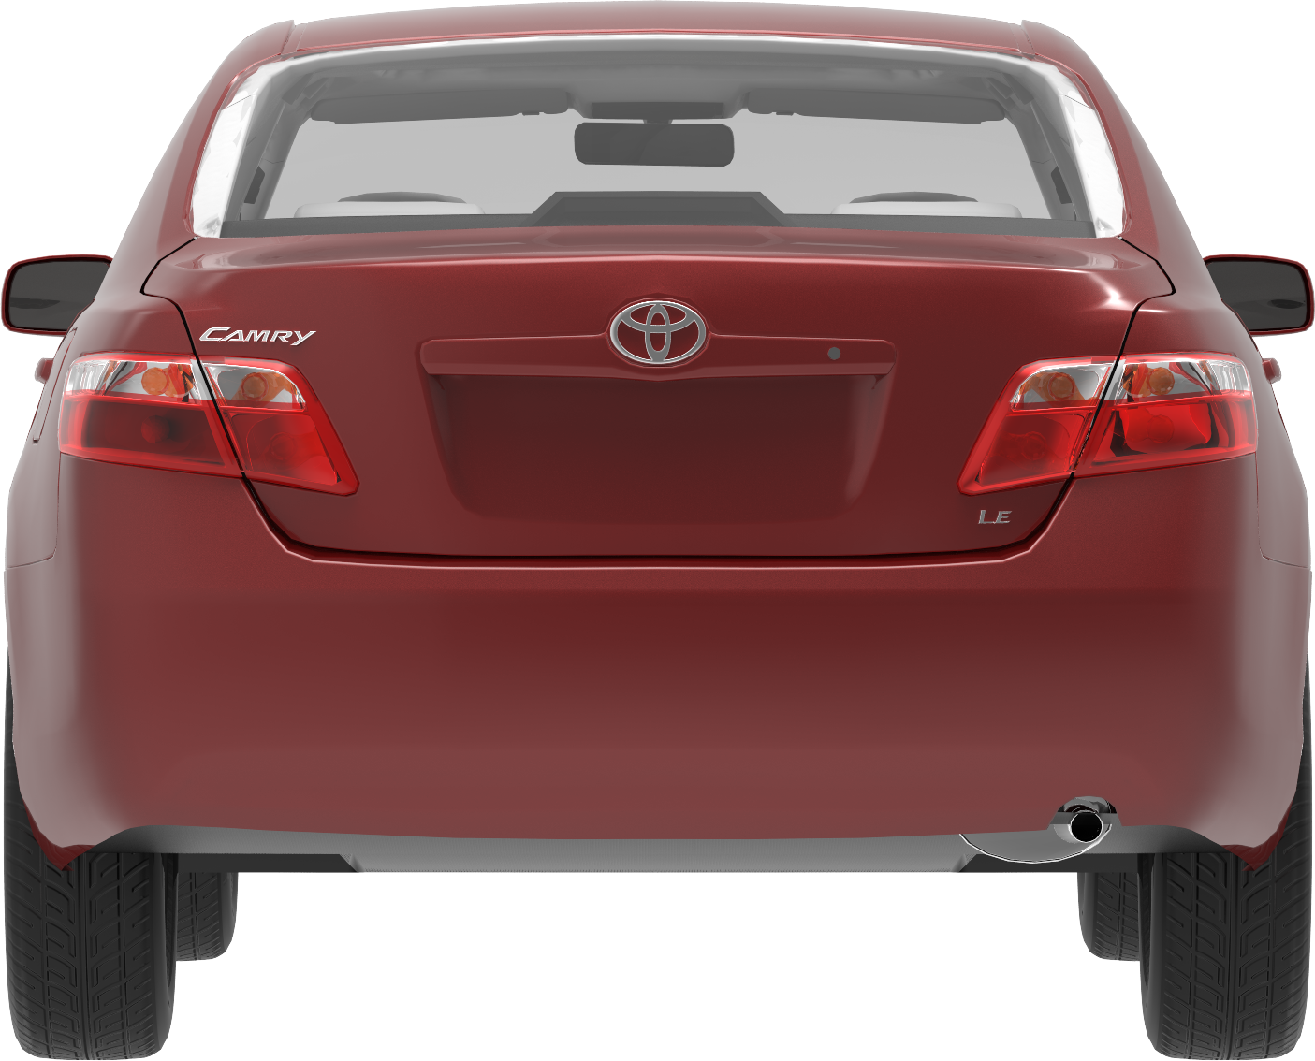
Which one is more likely to roll over?
Notes:
Vehicle balance is more difficult in taller vehicles. This Range Rover has a higher center of mass and will roll more easily than the Toyota. Typically, you also see recreational equipment such as kayaks, canoes, and bicycles on racks above the SUV.

Slide 57
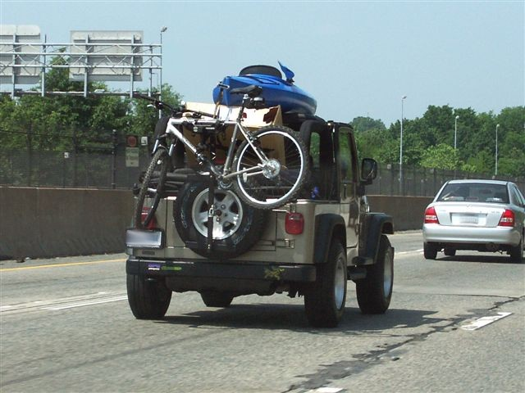
What about this vehicle’s center of gravity?
Notes:
What will happen to the center of gravity when more gear is added to the top of a vehicle? What will happen if the driver takes a curve at the speed she normally does with the new higher center of gravity?

Slide 58
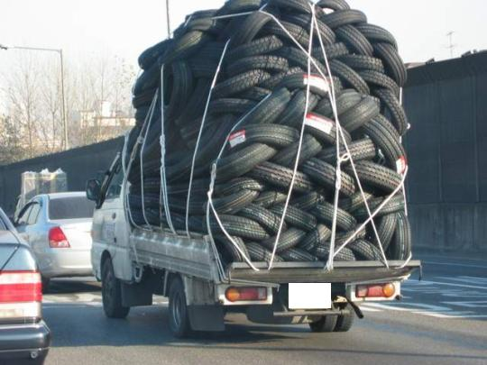
Notes:
This vehicle is exceeding maximum load and also has a much higher center of gravity. What do you think the vehicle and its load will do if he swerves to avoid a car that slams on its brakes?

Slide 59
Putting it all Together
What can I do to work within natural laws to manage risk and drive more safely?

Slide 60

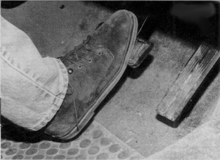
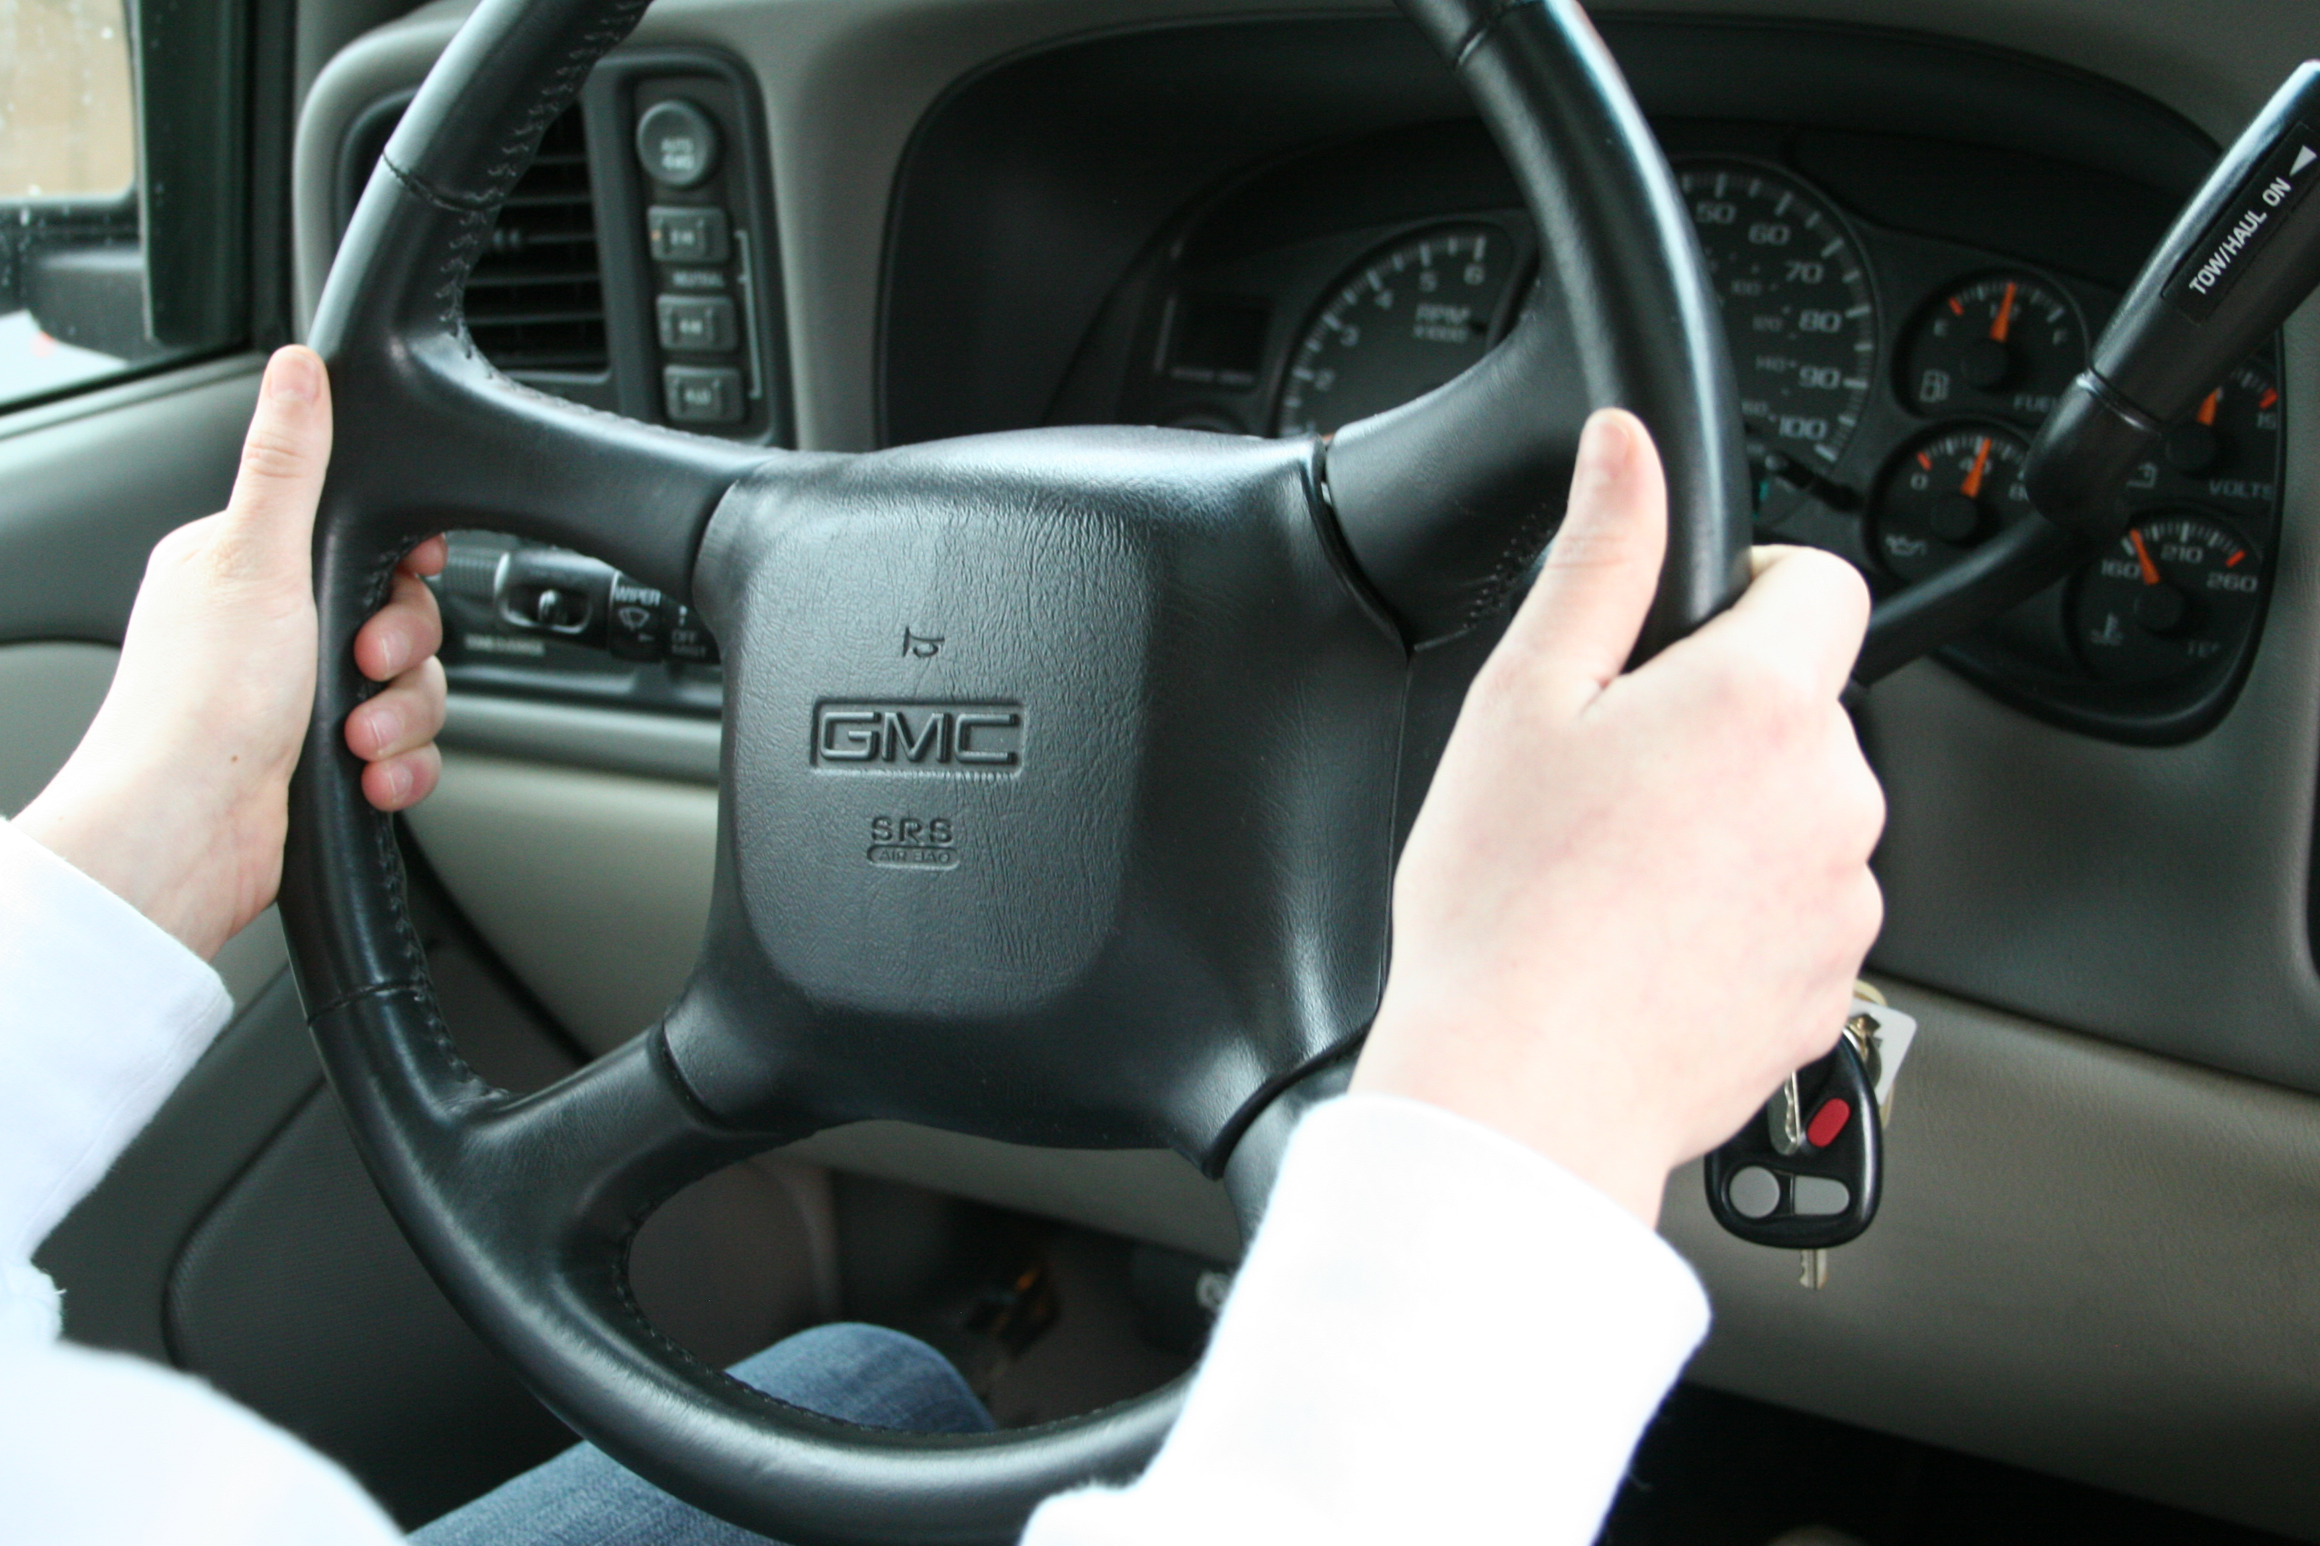
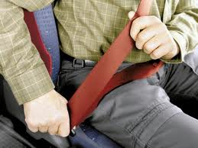
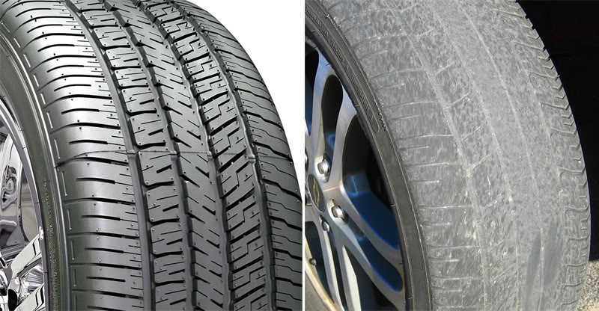
Manage Natural Laws by:
Controlling vision
Controlling motion
Controlling steering
Protecting occupants
Maintaining your vehicle
Notes:
Each of these items has a following slide to discuss what the driver needs to do to keep the car safely on the road and manage the forces if they are in a crash.

Slide 61
Look at the following slides …
Using Vision Control, determine how you would manage the natural laws with
  Speed (motion) control
  Steering control
Notes:
The purpose of this activity is to put all the pieces together. The driver needs to understand that managing natural laws all starts with the ability to recognize that a change is occurring and that they need to take action to manage that change. The change can be snow, rain, frost, gravel, curve, hill, cars stopped, stop sign, etc.
Once the change is identified, then the driver needs to make some decisions. If the driver chooses not to take action or improperly identifies the appropriate change, they run the risk of mishandling the forces and possibly crash their vehicle.

Slide 62
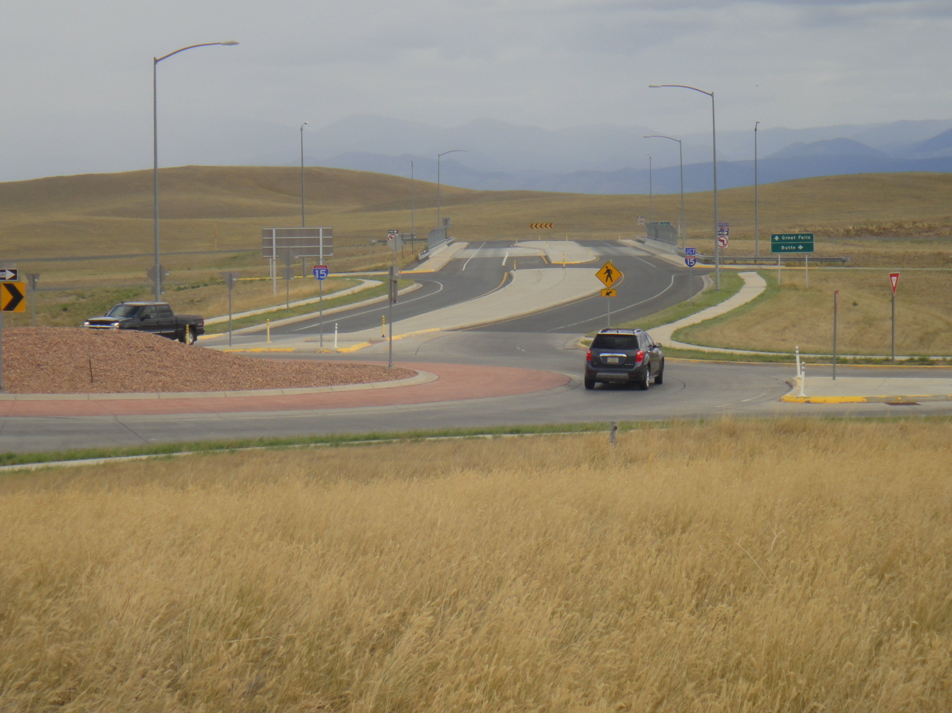
Notes:
A roundabout in nice weather.

Slide 63
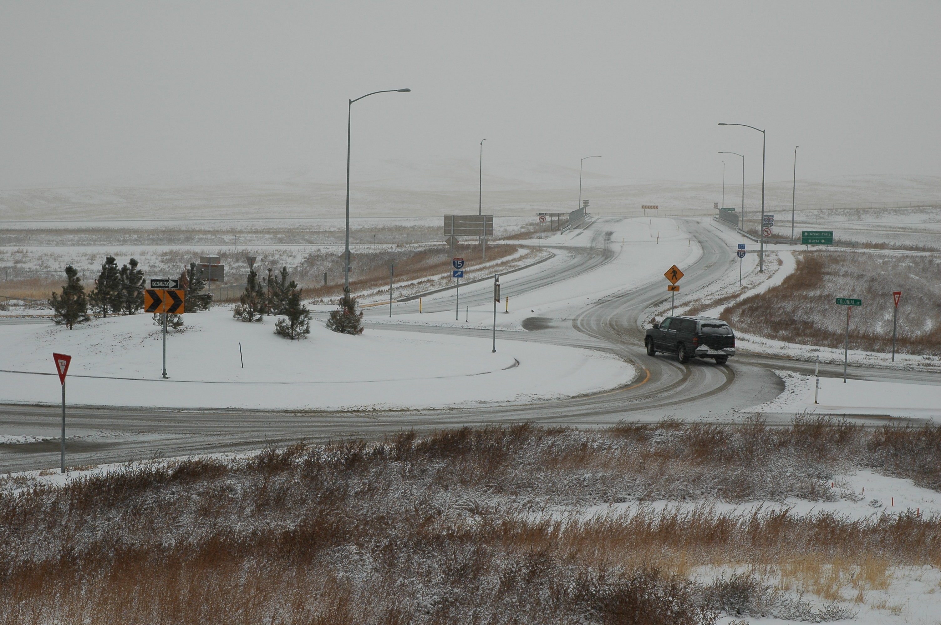
Notes:
Here is the same roundabout in early winter. Notice that snow now changes the car’s traction and ability to manage the forces created by the car going around the roundabout. If you look closely at the tire traction patterns, you will see that the rear tires are not in the front tire tracks and that the rear of the car is yawing out of the curve.
Questions you may wish to ask:
How is this picture different than the one in the previous slide?
What changes have occurred that the driver needs to manage?
Describe what the driver needs to do with her vision as she gets ready to exit this curve.
How is this driver managing the forces and natural laws as she drives around this roundabout?
What did the driver do to cause the vehicle to begin to yaw?
Too much speed in this part of the curve, slight downhill and negative camber on the curve will cause the car to yaw or early acceleration before the transition peg.

Slide 64
Vehicle Maintenance
Tires
Brakes
Fluid levels
Routine maintenance
Notes:
Tires provide traction and the opportunity to turn, slow down, stop and accelerate.
Brakes wear over time and stopping becomes more difficult to slow and stop.
Fluid levels can change over time and if levels get low brake pressure decreases or disappears. Washer fluid in the window washer lets you clean the window in bad weather conditions.
Routine maintenance means taking care of your car on a regular basis. Checking fluid levels--oil, transmission fluid, power steering fluid, washer fluid, etc. and making sure the tires are inflated at their correct pressure are only a few of the things you need to do on a regular basis. You will also want to clean the windows inside and out and make sure your headlights are clear of road grime and dirt.
Remember, your car is the second largest purchase you will make in your life and you need to take care of it so it will last longer and be safer for your driving career.

Slide 65
Occupant Protection
Vehicle Design and Natural Laws
Safety Belts and Safety Seats
Air Bags
Notes:
You can ask the students:
What are the physics principles that contribute to the design of vehicles to protect occupants from serious injury or death in the event of a crash?
If a car is outfitted with airbags, is it necessary to buckle up? Explain.
What is a “backseat bullet?”
Refer to Module 2.1 (slides 13 and 14) on the importance of buckling up, and Module 5.3 Protecting Occupants for a detailed overview of the natural laws governing the movement of vehicles and bodies in space, and how seat belts, child safety seats, air bags, and vehicle design combine to protect occupants in the event of a crash.

Slide 66
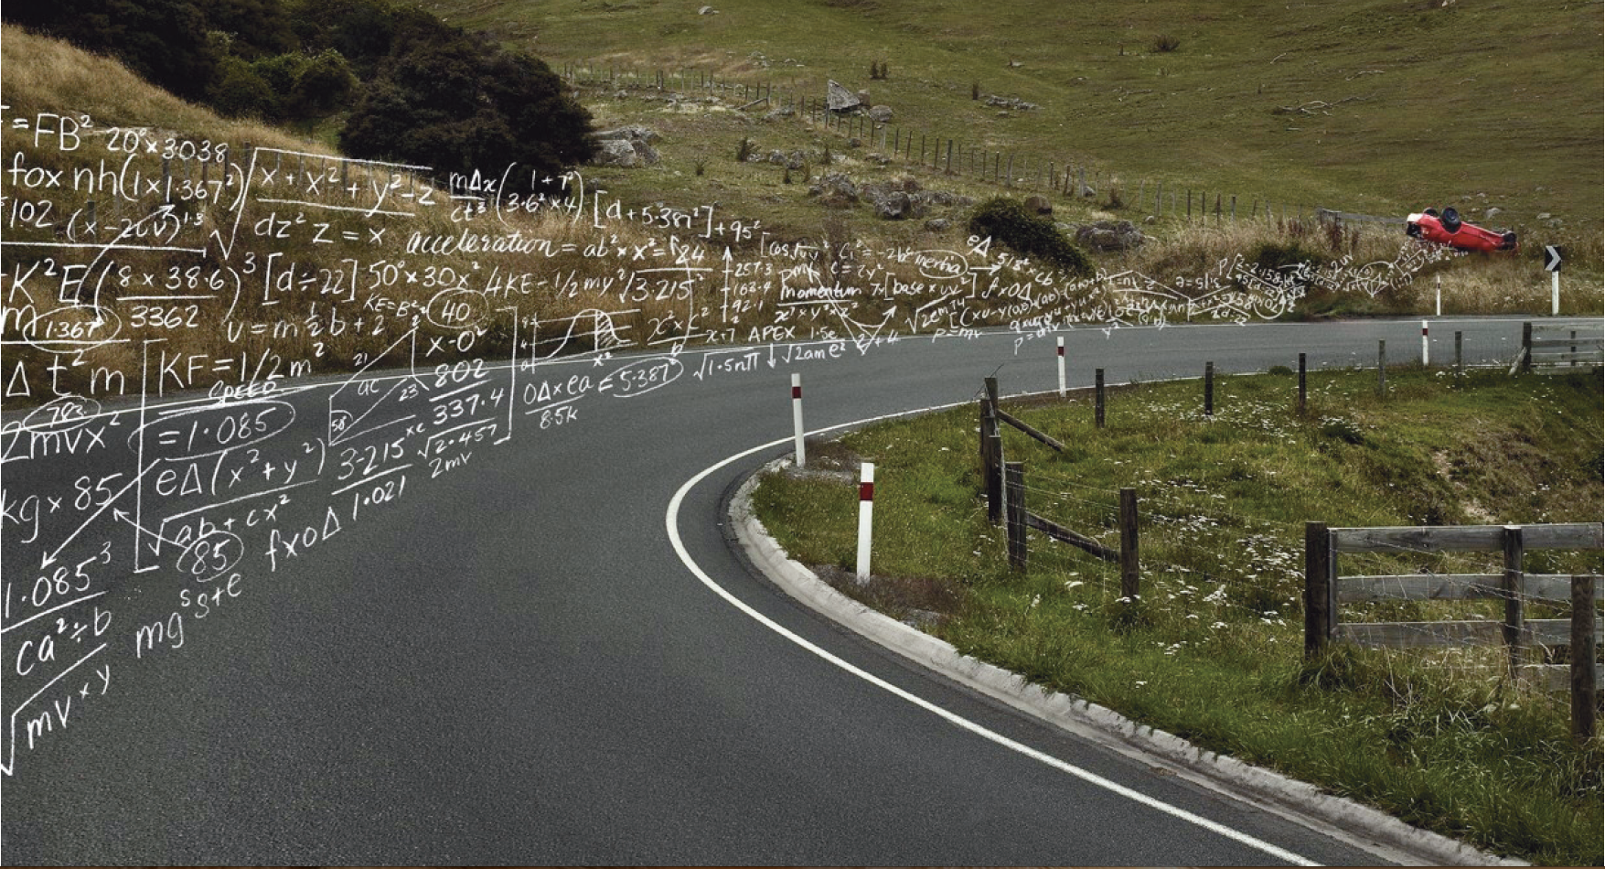
You can’t beat physics—SLOW DOWN!
ARRIVE ALIVE

Slide 67
Montana Driver Education and Training
Standards and Benchmarks
1. Laws and Highway System
  1.1. know the laws outlined in the Montana Driver's manual;
  1.2. understand the laws outlined in the Montana Driver's Manual; and
  1.3. consistently demonstrate knowledge and understanding by responsible adherence to highway transportation system traffic laws and control devices.
2. Responsibility
  2.1. recognize the importance of making safe and responsible decisions for owning and operating a motor vehicle;
  2.2 demonstrate the ability to make appropriate decisions while operating a motor vehicle;
  2.3. consistently display respect for other users of the highway transportation system; and
  2.4. develop positive habits and attitudes for responsible driving.
3. Visual Skills
  3.1. know proper visual skills for operating a motor vehicle;
  3.2. communicate and explain proper visual skills for operating a motor vehicle;
  3.3. demonstrate the use of proper visual skills for operating a motor vehicle; and
  3.4. develop habits and attitudes with regard to proper visual skills.
4. Vehicle Control
  4.1. demonstrate smooth, safe and efficient operation of a motor vehicle; and
  4.2. develop positive habits and attitudes relative to safe, efficient and smooth vehicle operation.
5. Communication
  5.1. consistently communicate driving intentions (i.e., use of lights, vehicle position, and personal signals);
  5.2. adjust driver behavior based on observation of the highway transportation system and other roadway users;
  5.3. adjust communication (i.e., use of lights, vehicle position, and personal signals) based on observation of the highway transportation system and other users; and
  5.4. develop positive habits and attitudes for effective communication.
6. Risk Management
  6.1. understand driver risk-management principles;
  6.2. demonstrate driver risk-management strategies; and
  6.3. develop positive habits and attitudes for effective driver risk-management.
7. Lifelong Learning
  7.1. identify and use a range of learning strategies required to acquire or retain knowledge, positive driving habits, and driving skills for lifelong learning;
  7.2. establish learning goals that are based on an understanding of one’s own current and future learning needs; and
  7.3. demonstrate knowledge and ability to make informed decisions required for positive driving habits, effective performance, and adaptation to change.
8. Driving Experience
  8.1. acquire at least the minimum number of BTW hours over at least the minimum number of days, as required by law, with a Montana-approved driver education teacher; and
  8.2. acquire additional behind-the-wheel driving experience with a parent or guardian’s assistance in a variety of driving situations (i.e., night, adverse weather, gravel road, etc.).
Notes:
Standards and Benchmarks: This is for your reference and not to be read to the class verbatim. Please review prior to the lesson so you are aware of what the student will be required to know at the end of the module.

